Slide 1
Presentation about Progress in NRSR
Jiayu Chen
2023.7.31
Notes:
Noise reduction and signal reconstruction.

Slide 2
Work
Plan
Current Situation
Questions
Notes:
I will divide my presentation into 4 parts:
Part 1, I will introduce the work I did this week
Part 2 is some plans for completing this project
Part 3 is some analyses of the current status of this project
In Part 4, there are some issues and questions in my learning.

Slide 3
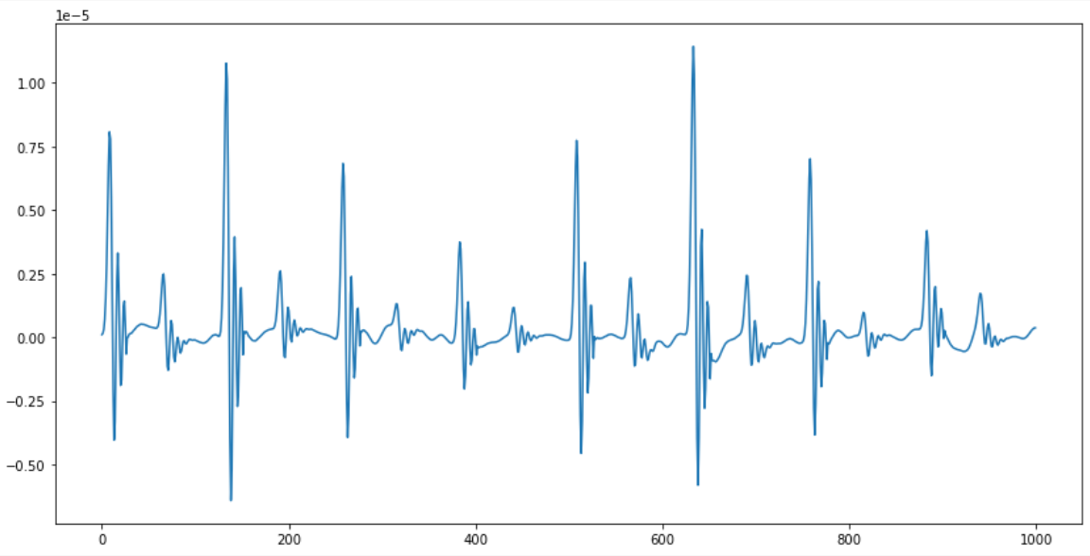
Work: Stack Signals and Get Template Heartbeat Signal
Find Peaks
Focus on the position of large peaks
and ignore small peaks.
Choose Distance
Use methods different from reference
paper.
Slice Signals
Padding
For sliced signals with insufficient length, pad zeros at the end.
Reference:
Rasti-Meymandi A, Ghaffari A. A deep learning-based framework For ECG signal denoising based on stacked cardiac cycle tensor[J]. Biomedical Signal Processing and Control, 2022, 71: 103275.
Stack Signals
Transform a 1D signal into 2D.
Compute the average
Merge N signals into 1 signal.
Get Template Heartbeat Signal
Notes:
Prof Song, About three days ago, you once mentioned in the group chat that if we can find a way to stack signals and get one template heartbeat signal with high signal-to-noise ratio.
I only found one paper about stacking, and after reading this paper, I borrowed some methods from the paper. To achieve this goal, it requires seven steps.
First, find the locations of the peaks. Here we only need to focus on the large peaks and ignore the small peaks.
Second, with the large peak locations as the core, choose suitable distances. This is the most important step, but because features of my data are different from the paper’s data, I improved on their method. I will explain this method in detail on the next page.
Third, slice the entire signal.
Fourth, since the sliced signals won't be exactly equal length, we need to pad 0s at the end of the signal.
Fifth, stack these sliced signals. We will transform a 1D signal into 2D.
Sixth, compute the average, turning N signals into 1 signal. This step didn't appear in the paper, it was my own idea, I'm not sure if doing this is effective.
Finally, we get the template heartbeat signal.

Slide 4
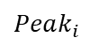
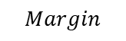
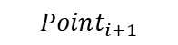
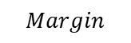

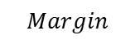

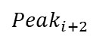

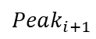
Work: Stack Signals and Get Template Heartbeat Signal – Choose Distances
$$Peak_{i}$$
$$Peak_{i+1}$$
$$Peak_{i+2}$$
Method Offered by Paper
$$Point_{i}$$
$$Point_{i+1}$$
$$Point_{i}=\frac{Peak_{i}+Peak_{i+1}}{2}$$
$${ Length}_{i}=Point_{i+1}−Point_{i}$$
Disadvantages:
The small peaks are cut open and features cannot be extracted.
The first and last segments of the signal need to be padded with so many 0s.
One piece of sliced signal
$$Margin$$
$$Margin$$
$$Margin$$
$$Margin$$
$$Margin$$
My Method
$$Margin=Peak_{0}$$
Advantages:
Small Peaks are reserved well.
Each segmented signal needs almost no padding.
One piece of sliced signal
Notes:
Next, let's look at how to choose the distances.
The method provided in the paper is: take the average of the positions of two large peaks, and get a point. By subtracting adjacent points，we can get the length of each sliced signal.
This method has two very important Disadvantages:
Small peaks are cut open, and features cannot be extracted. The blue points in the picture is midpoints and the red part is one piece of sliced signal. And you can see, their small peaks are cut open.
2. The first and last segments of the signal need to be padded with so many 0s.
My method is as follows:
Take the position of the first large peak as the Margin. Slicing signals based on this method can preserve the small peaks well, and requires almost no padding.

Slide 5
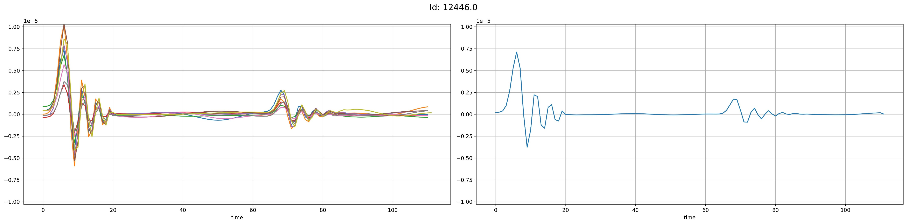
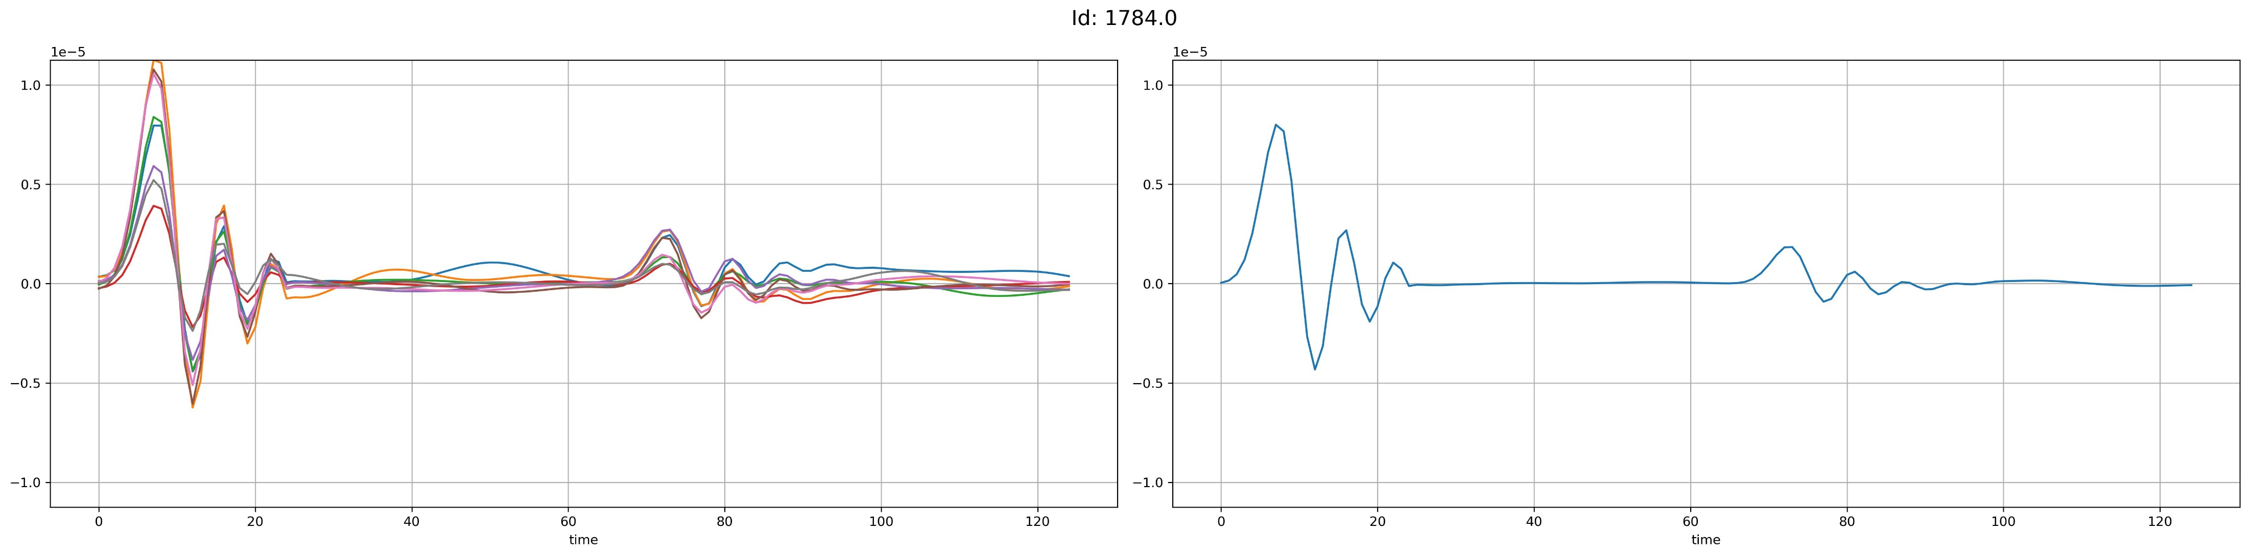
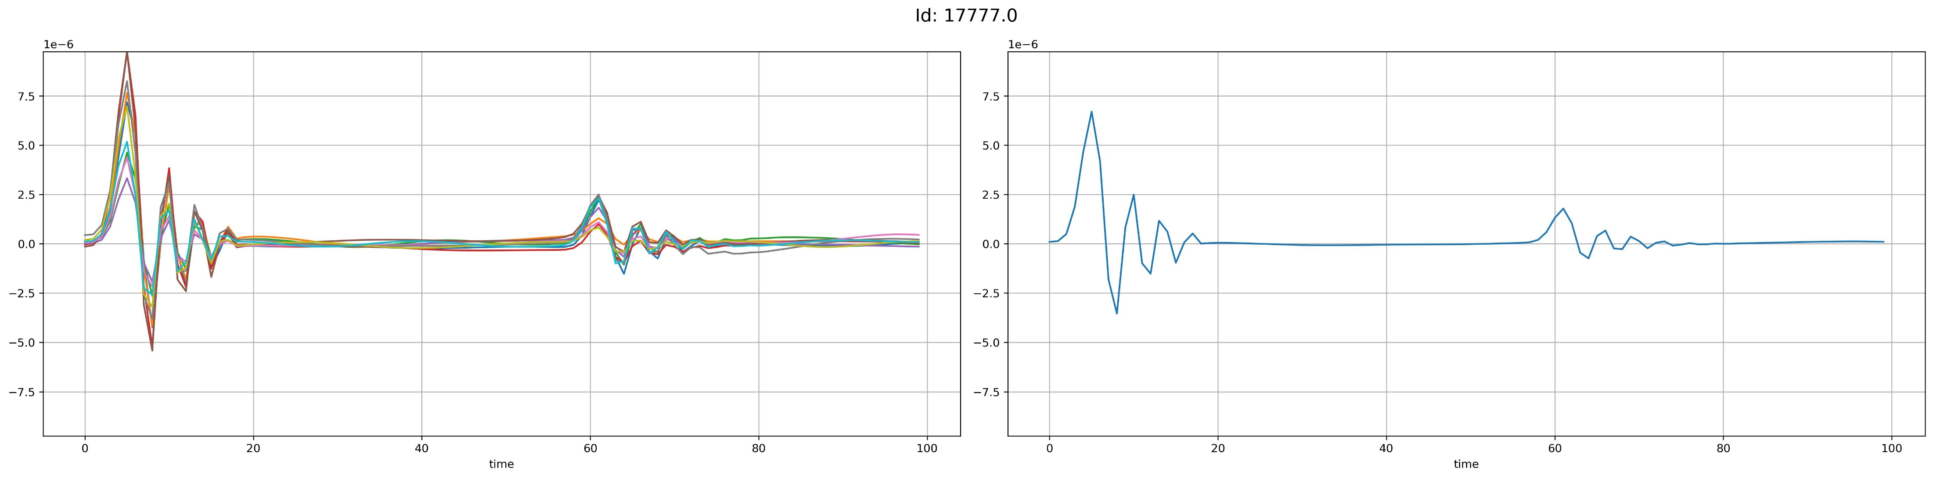
Work: Stack Signals and Get Template Heartbeat Signal
Performance Showcase
Stacked Signals
Template Heartbeat Signal
After taking the average
Notes:
let's look at the results.
The three graphs on the left are the Stacked Signals, and the three on the right are the Template Heartbeat Signals after taking the average.
Of course, all three sets of graphs show relatively good results.

Slide 6
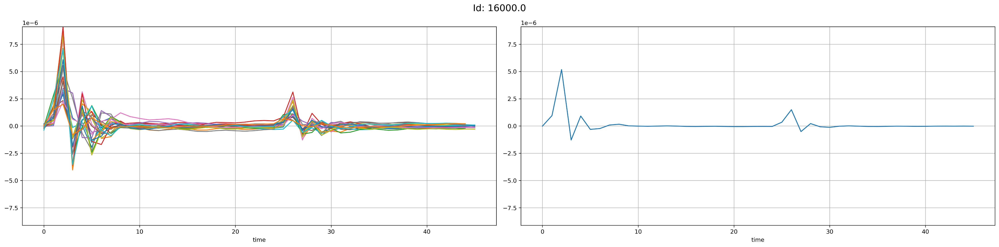
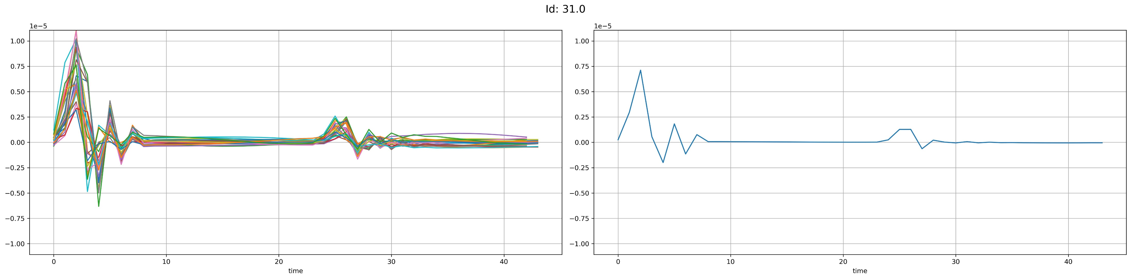
Work: Stack Signals and Get Template Heartbeat Signal
Problem1
Problems
Reduction in the amplitude of the signal.
Signals with negative values are almost impossible to extract.
The peak value of the signal disappeared.
After being stacked, signals have a huge difference in time length.
Problem2
Problem3
Problem4
Possible solution for Problem 4: Downsample the long duration signal template.
Notes:
This method also has some problems
First: The amplitude of the signal peaks decreases after getting the average.
Second: Signals with negative values are almost impossible to extract. The negative signals disappear.
Third: The signal peaks disappear. The second graph on the right.
Fourth: After being stacked, signals have a huge difference in time length.
Some are around a hundred milliseconds, some around 50 milliseconds.
Regarding Problem 4, I speculate that downsampling long duration signals could solve this problem.
At the same time, I think the second issue could have a large impact on final result.

Slide 7
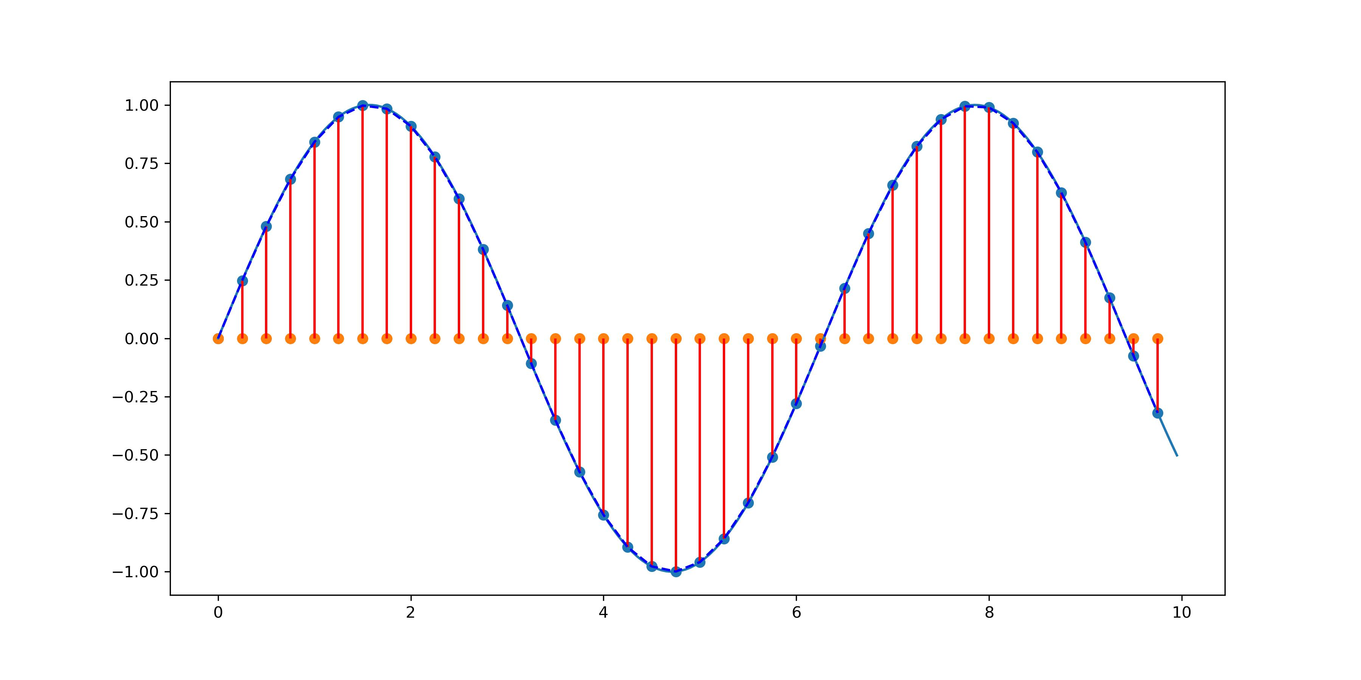
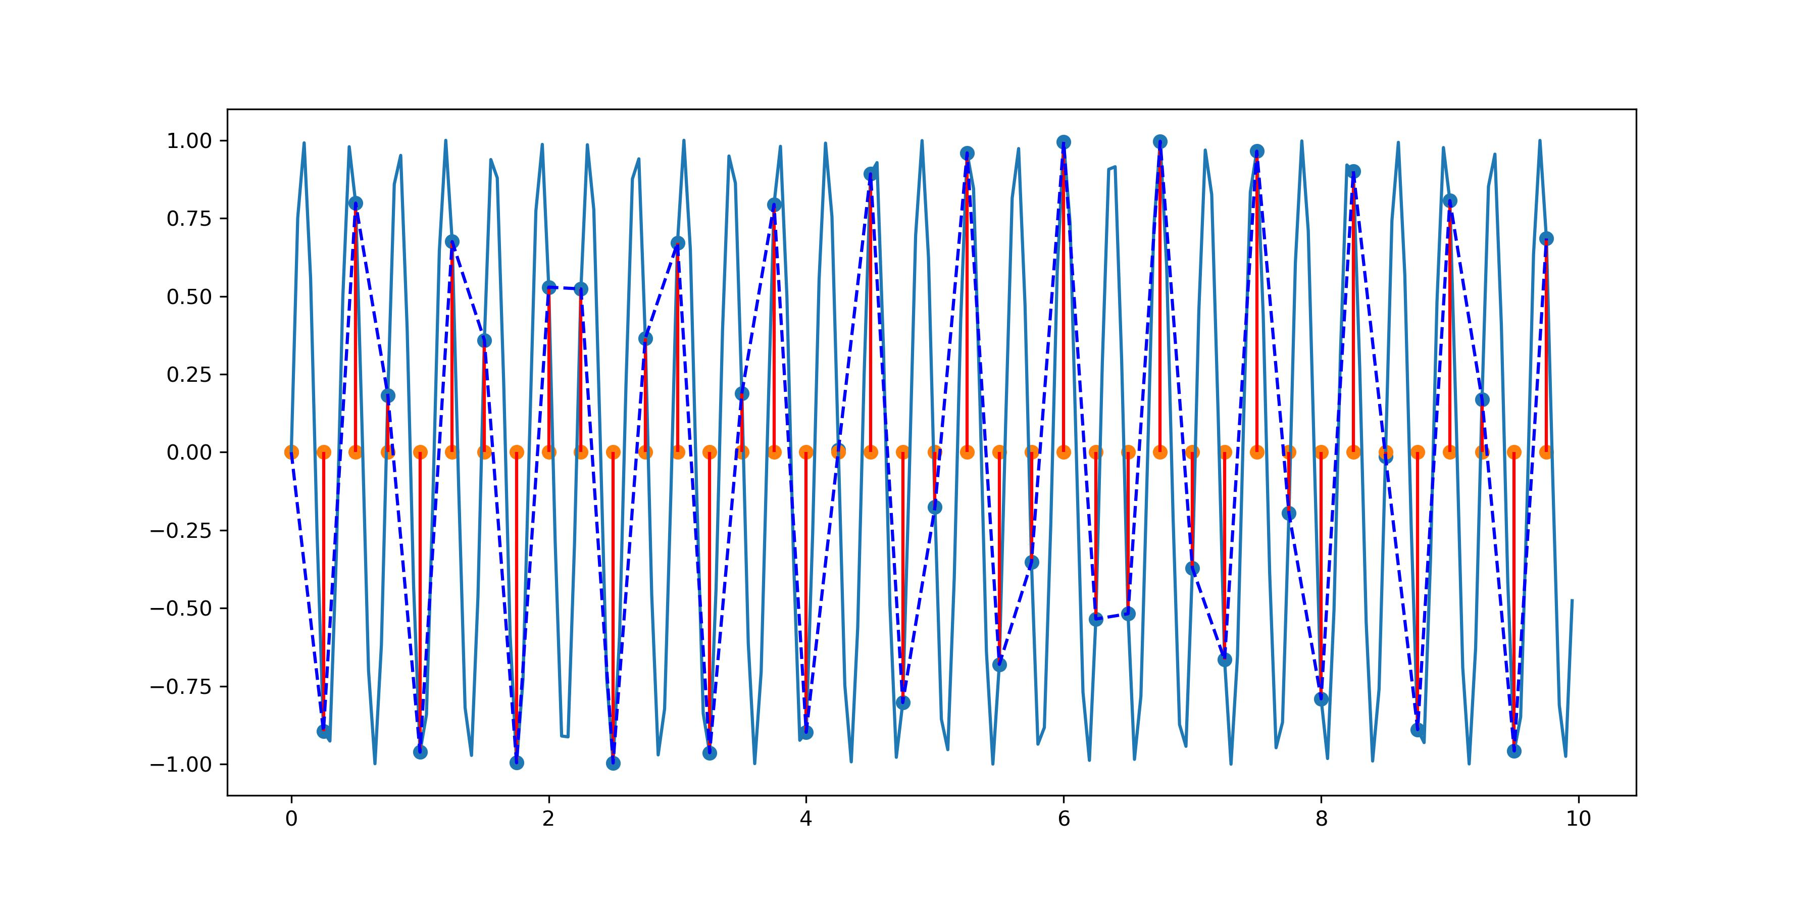
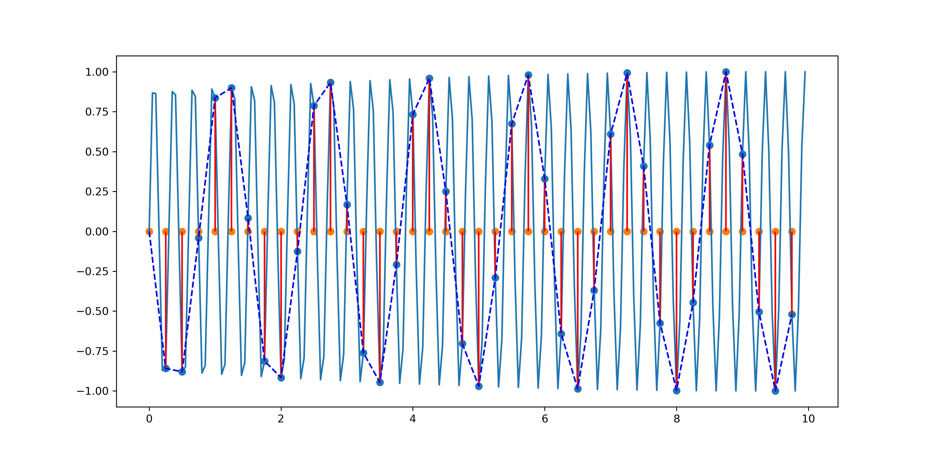
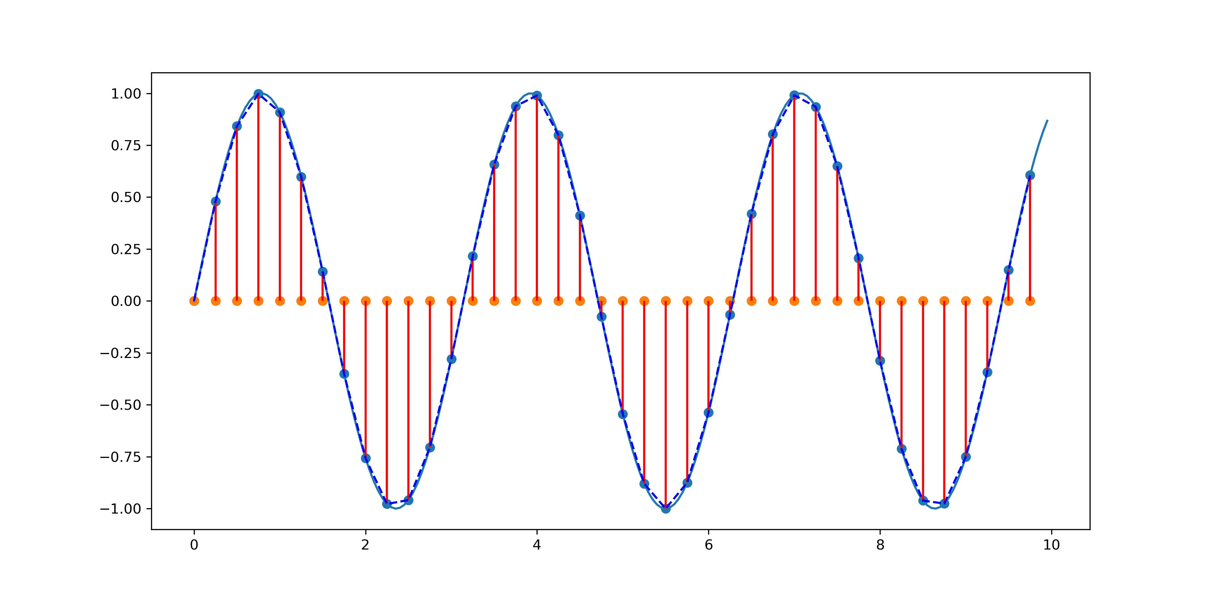
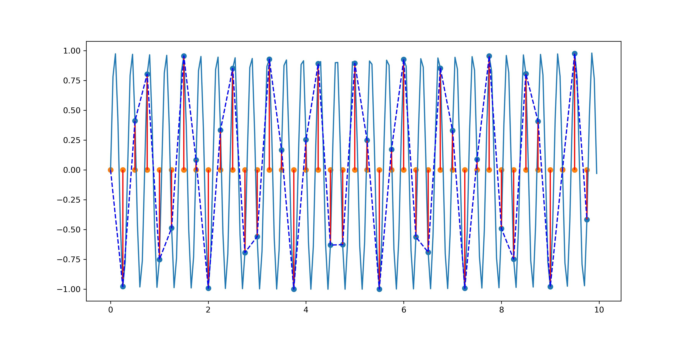
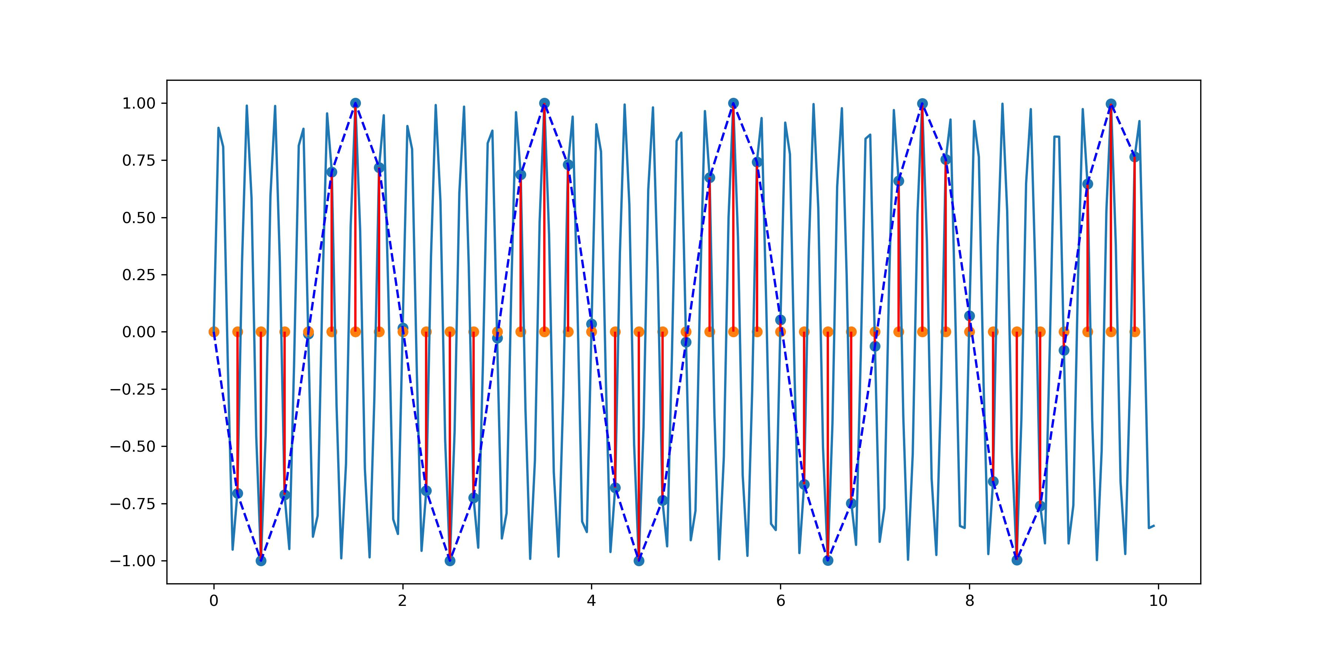
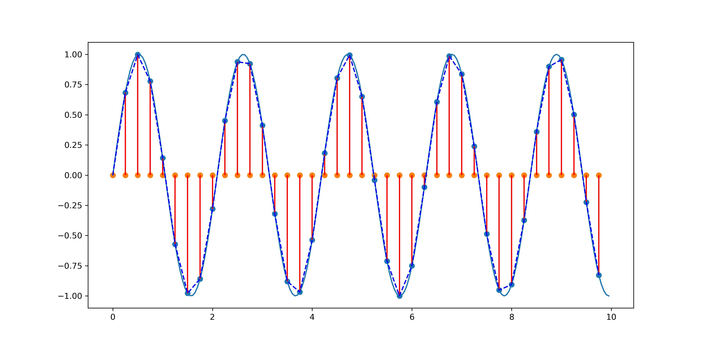
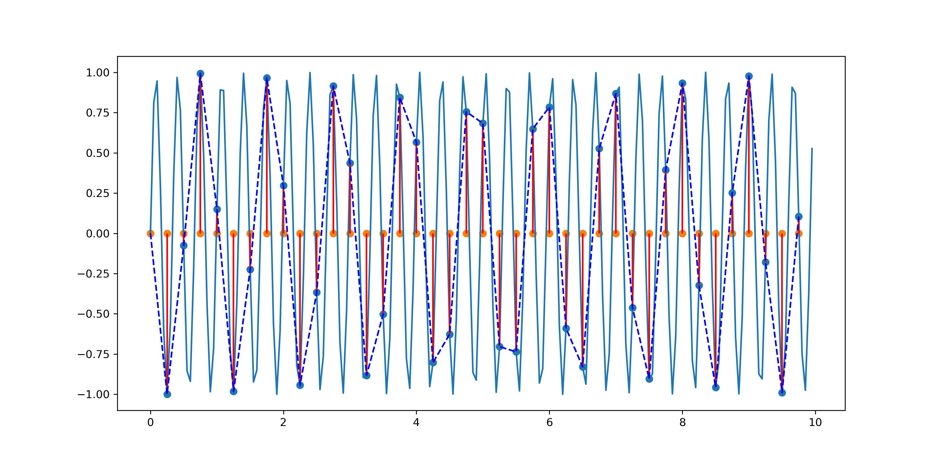
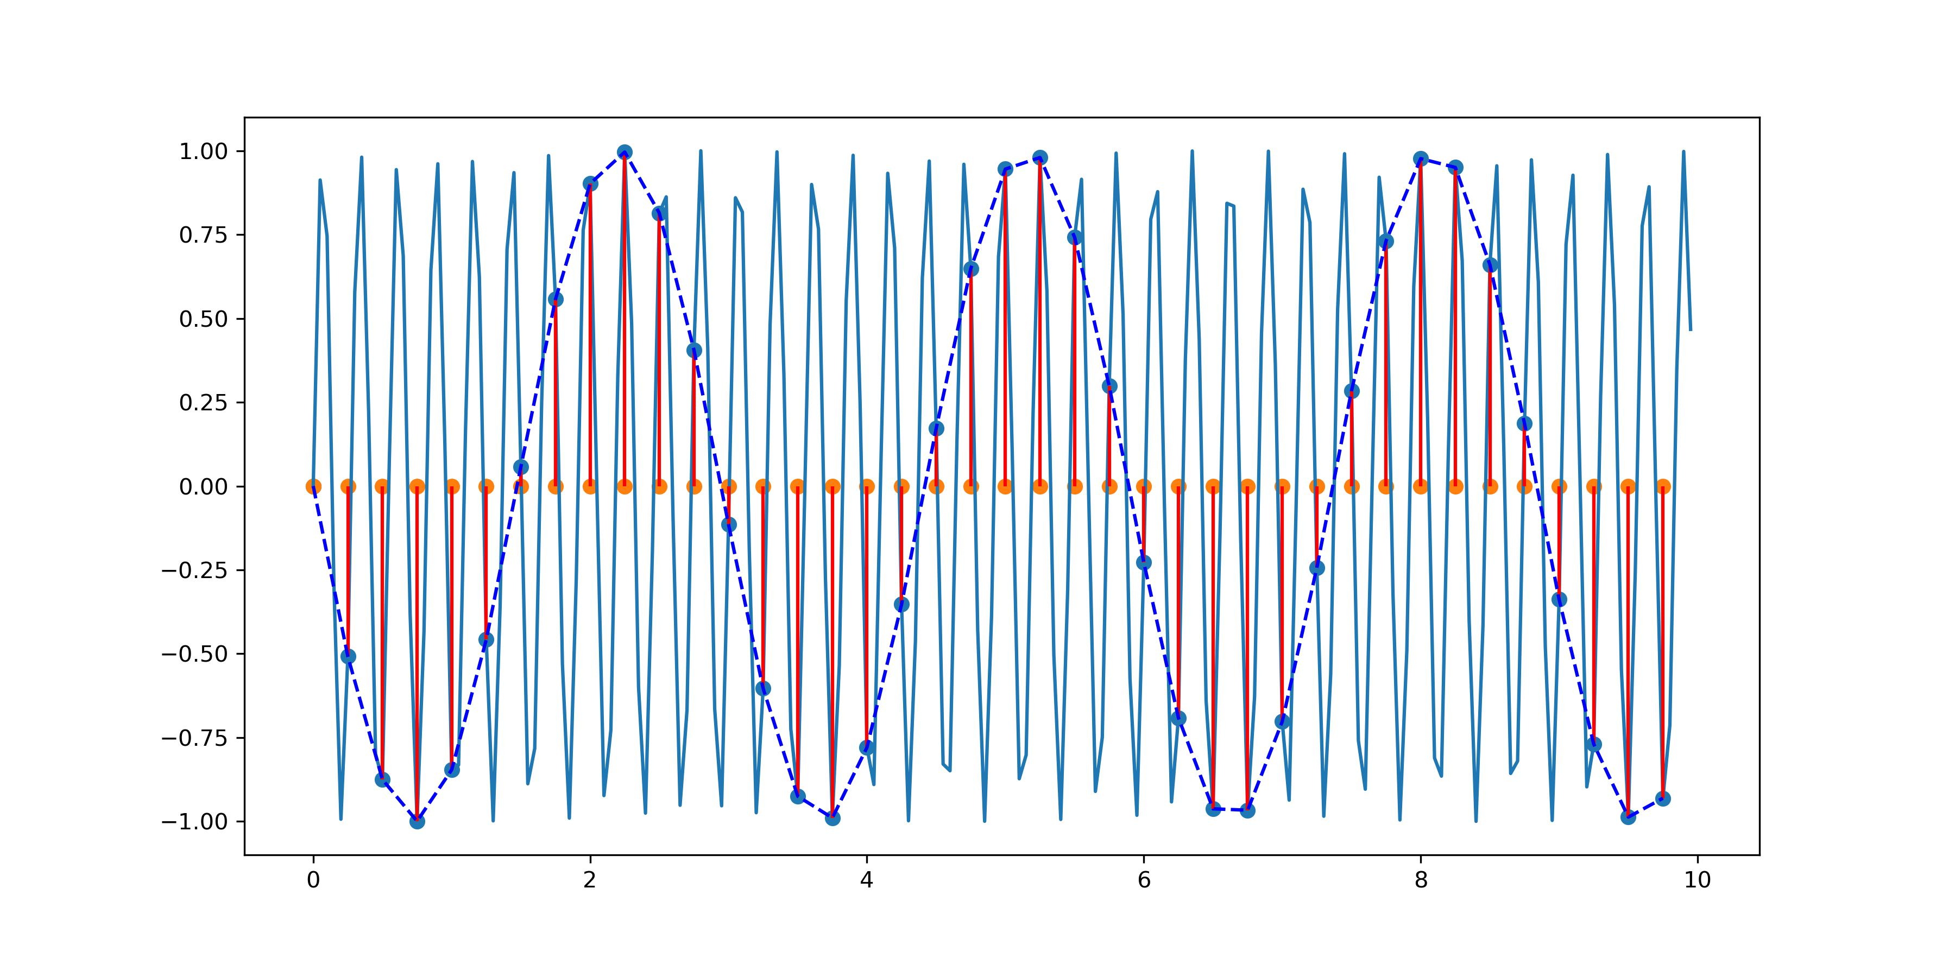
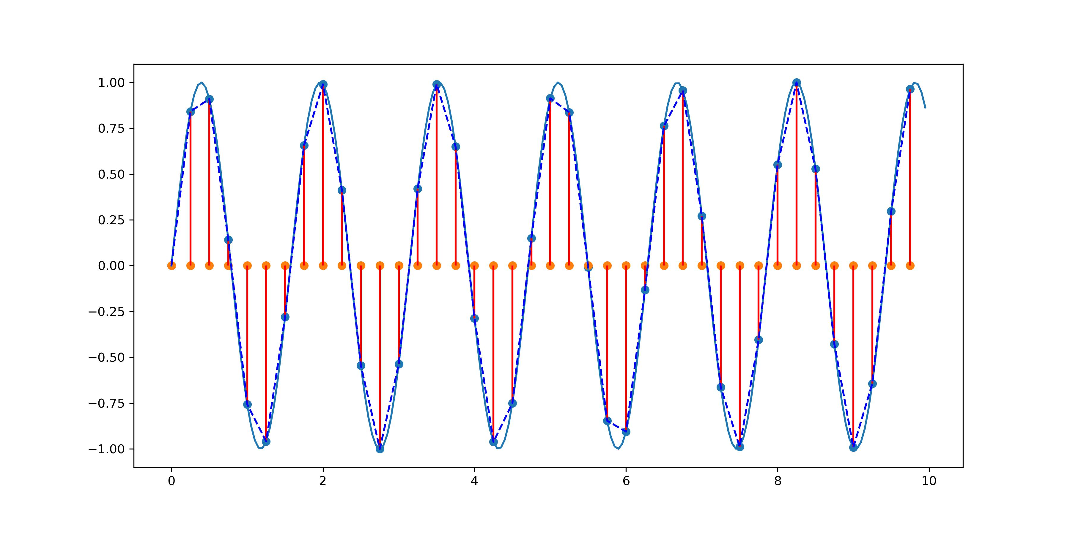
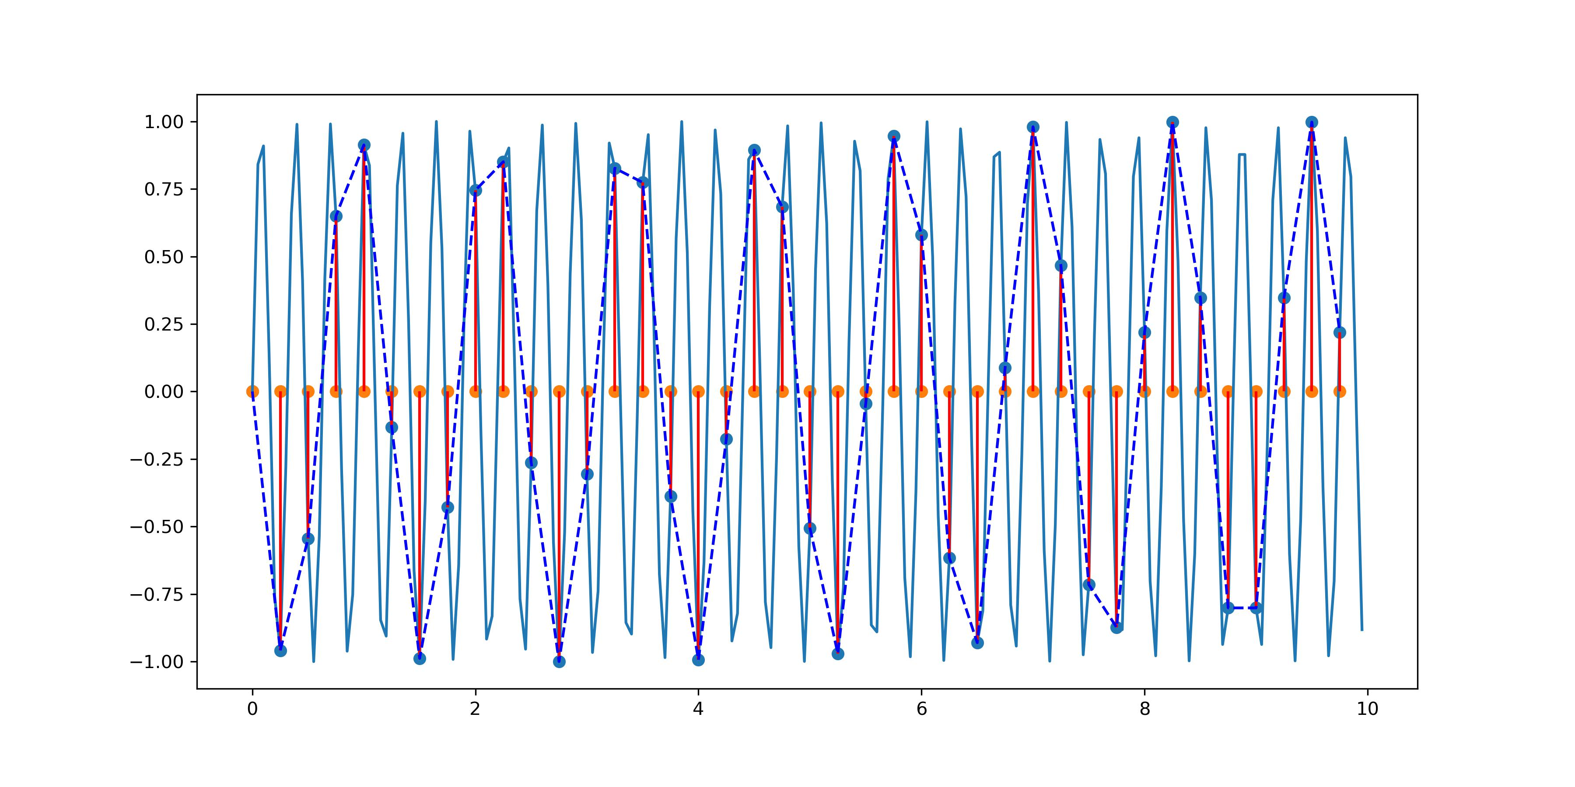
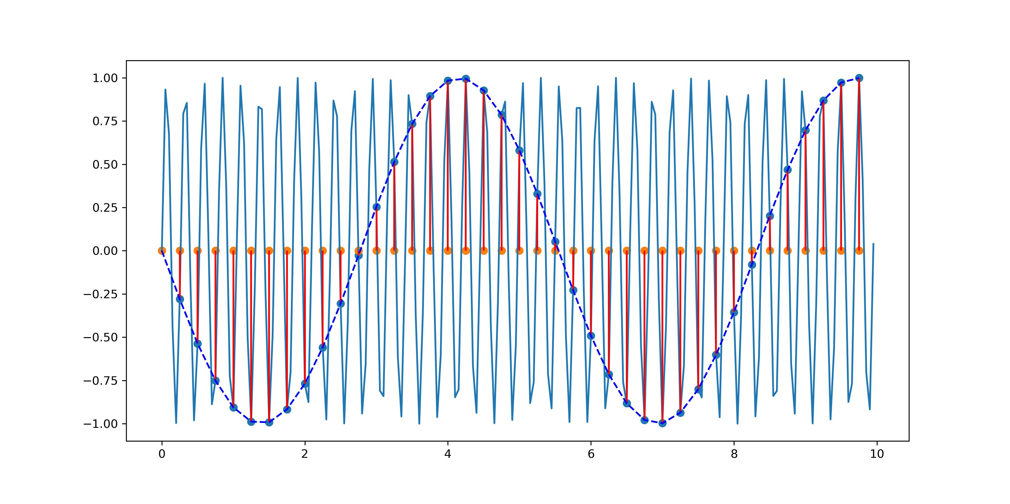
Work: Nyquist sampling theorem, which appears in Chapter 1 of Advanced Digital Signal Processing And Noise Reduction
Initially, I can hardly understand Nyquist theorem.
So I wrote a function in Python to show the intuitive meaning of Nyquist theorem. I let the frequency of the analog signal keeps increasing, while the sampling frequency remains constant.
Orange points: the sampled values,
Light blue: the original analog signal
Dark blue: reconstructed signal after sampling.
Effective Sampling
Sampling barely meeting
the Nyquist sampling theorem
Aliasing phenomenon,
leading to signal loss and distortion
Notes:
The second work is related to the Nyquist sampling theorem, which appears in Chapter 1 of the book "Advanced Digital Signal Processing And Noise Reduction".
Initially, I could hardly understand the Nyquist theorem.
So I wrote a function in Python to demonstrate the intuitive meaning of the Nyquist theorem. The frequency of the analog signal keeps increasing, while the sampling frequency remains constant.
In the right pictures, the orange dots represent the sampling points. The light blue represents the original analog signal. The dark blue means the reconstructed signal after sampling.
The four graphs on the left show effective sampling. The four graphs in the middle are already very close to the limit of the Nyquist sampling theorem. four graphs on the right show aliasing phenomenon.
This leads to signal loss and distortion.
This method provides a very intuitive understanding of the sampling theorem.

Slide 8
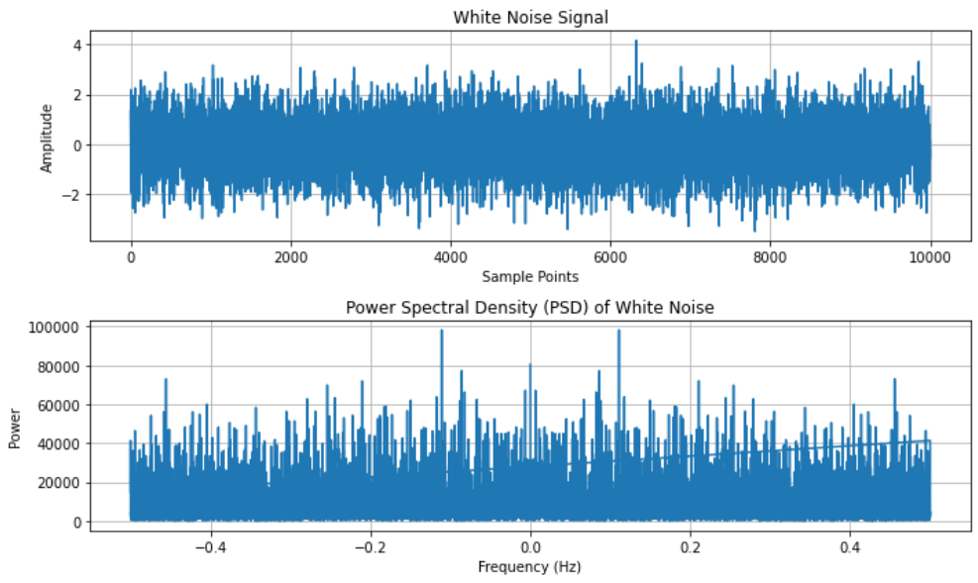
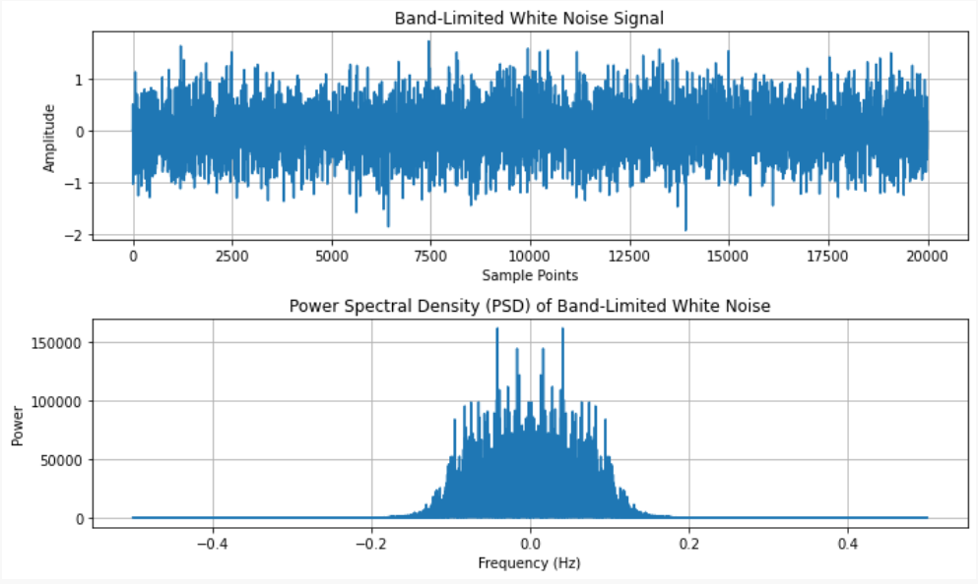
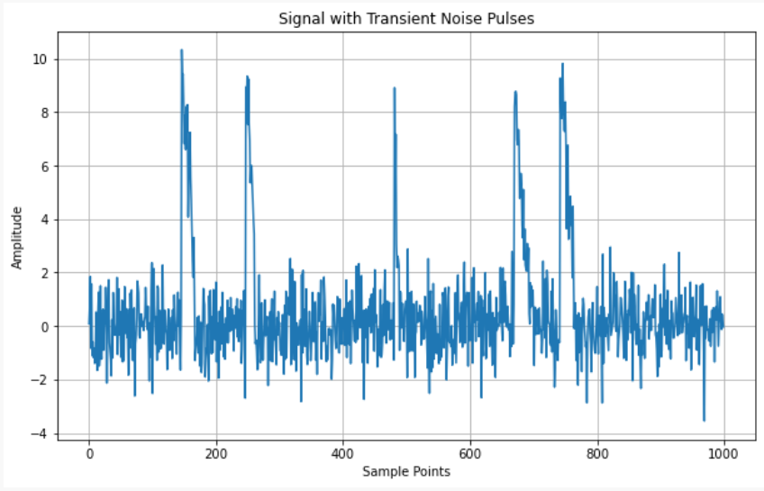
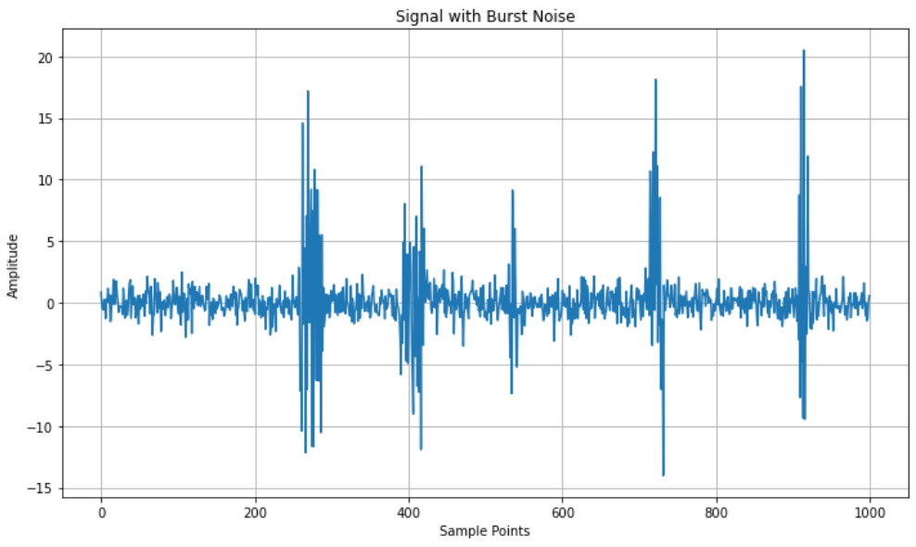
Work: Noise Simulation
Read the 1st and 2nd chapters of the book Advanced Digital Signal Processing And Noise Reduction.
Write codes to simulate some types of noises, summarize their nature briefly, and plot them.
White Noise
Band-Limited White Noise
Transient Noise
Burst Noise
Notes:
The third work is Noise Simulation.
Introductions to noise appear in Chapter 1 and Chapter 2 of the book "Advanced Digital Signal Processing and Noise Reduction". I write codes to simulate some types of noises, briefly summarize their characteristics, and plot them.
Common noises include white noise, band-limited white noise, transient noise, and burst noise.

Slide 9
Work: Theoretical knowledge Learning
Signals and Systems
Function of Complex Variables
Course:
EE120, Berkeley (with 6 labs)
Goal:
Complete 6 labs and incorporate them into our tutorial.
This week's progress:
Linear Time Invariant Systems:
Lecture 1 (signals; system properties)
Lecture 2 (convolution)
Lecture 3 (response to exponentials)
Course:
A tutorial on Bilibili
Goal:
Master the knowledge of complex analysis required for other specialized courses.
This week's progress:
Operations with complex numbers
Euler's formula
Some concepts related to complex functions.
Notes:
The fourth part is some theoretical knowledge learning. This mainly includes two courses. The first is Signals and Systems. The second is Function of Complex Variable.
For Signal and Systems, I‘m taking a course from UC Berkeley. My goal is to complete 6 labs and incorporate these labs into our tutorial.
This week, I studied the Linear Time Invariant Systems chapter, which contains 3 lectures.
For Function of Complex Variable, I'm following a tutorial on Bilibili. My goal is to master the complex analysis knowledge required to complete other specialized courses.
This week I learned about Operations with complex numbers; Euler‘s formula and Some concepts related to complex functions.

Slide 10
Work: Time Review
Theoretical knowledge Learning
Read Books and Coding
Prepare the Presentation
Notes:
Next is my time breakdown for this week.
The yellow parts are the time I used to learn theory.
The blue parts are time for reading books and coding.
The gray is time spent preparing this presentation.

Slide 11
Plan
Today
Application Materials
Signals and Systems
Function of Complex Variable
Bayesian Inference
Hidden Markov Models
Reading books, Coding
Chapter 1, 2
Chapter 3, 4
Chapter 3, 5
Chapter 6
Chapter 7
Chapter 8
Chapter 9
Start
Week1
Week2
Week3
Week4
Week5
Week6
Week7
Week8
Notes:
Next is my Plan for this project.
I feel this project can hardly be done in just one month - it will require around 10 weeks.
Week 1, which is next week, I will finish writing my application materials, learn Signals and Systems, and learn Bayesian Inference, since Chapter 4 of the book is Bayesian-related content.
Week 2 will be similar to Week 1, mainly studying Hidden Markov Models

Slide 12
Current Situation
Comparison between our Tutorial and Neurokit2
 | Our lab’s Tutorial | Neurokit2
Positioning | Tutorial | Toolbox
Dataset | Unorganized | Well-Organized
Code Comments | A Few | Careful and extensive
Platform | Jupyter Notebook in Colab | Python file
Techniques | Statistics & Machine Learning | Statistics
Dependency | Numerous | Several
Add Descriptions to Datasets and Write More Code Comments!
Notes:
Next is the current status of our project compared to Neurokit2.
Because Professor Song, you asked us to refer to Neurokit2 when writing codes, I did a simple comparison of our project versus Neurokit2.
Our project is a Tutorial, Neurokit2 is a Toolbox, so there are many differences.
First is the dataset - ours data on GitHub is Unorganized, not only lacking folder organization but also lacking description of each dataset.
Second is code comments - the quality of our codes is good, but comments are too few. As a tutorial, the comments are really important.
In terms of platform, our exsiting codes are all written in Colab. It’s good.
Then technically, we basically have both statistical methods and machine learning methods.
At the same time, we found our tutorial has many dependencies. Generally, the more dependencies, the higher the likelihood of failure when others try to run it. Especially since our machine learning methods are all written in TensorFlow.
What's most important for us now is to add dataset descriptions and more code comments.

Slide 13
Questions
1. How to evaluate the denoising effect on the actual measured signals? How do I know that the
denoising method actually eliminates noise rather than critical signals?
2. Should the algorithms I learned in the book be employed on the dataset regarding predicting D and S?
3. Is there help with the derivation of math formulas? GPT or Mathematica?
Notes:
Next are some problems I have encountered in my learning.

Slide 14
Thanks!

